Slide 1
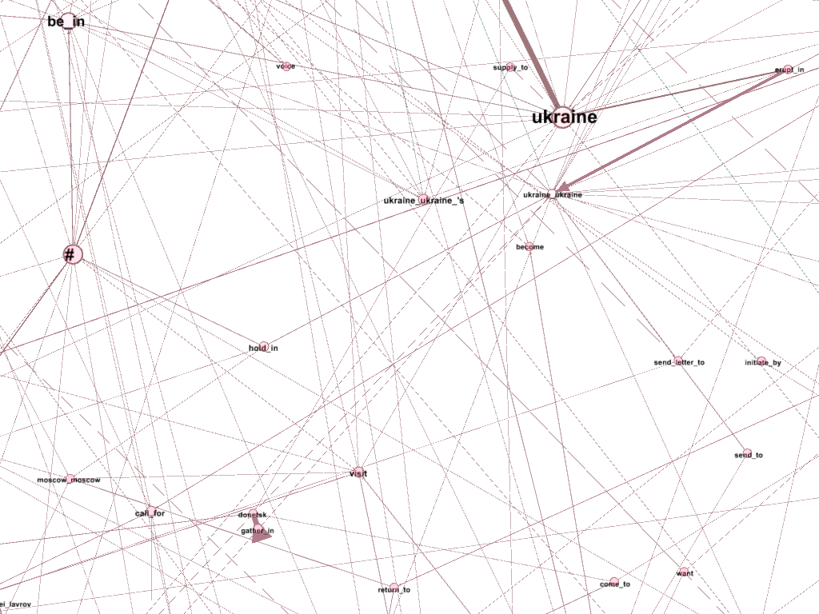
Extracting objective facts from subjective
and noisy sources
Kirill Tumanov
Panagiotis Chatzichristodoulou
Maastricht University
2014

Slide 2
Outline
Problem statement
Background
Information gathering
Preprocessing
Mining the text
Visualization
Remarks
Summary

Slide 3
Problem
Modern news agencies present the fact in a subjective and disputable way.
When it comes to understanding the situation, only facts matter.
Idea is to extract the set of facts from a list of sources to be able track the situation regardless of the way it is presented.

Slide 4
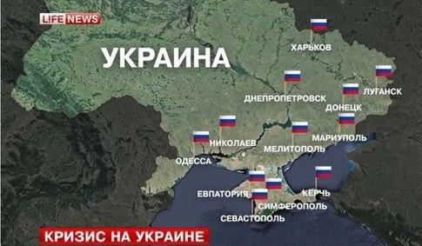
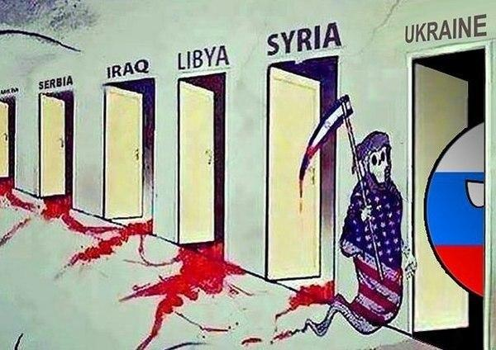
Background
Political crisis in Ukraine - the hottest topic of the days of the project - was selected for investigation.
News agencies from Russia, The West, China and Middle East were used as sources of the info on the topic.

Slide 5
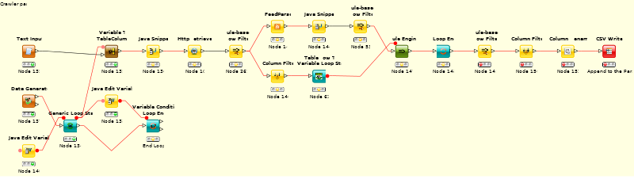
Data Retrieval
News agencies used:
Russia Today
CNN
Washington Post
Reuters
RIA Novosti
ITAR-TASS
Al-Jazeera
Xinhua
Tools involved:
- Perl
- KNIME

Slide 6
Preprocessing
Preprocessing steps needed:
Strip html tags on web pages-> Data reduction
Convert data to documents
Enrich documents with meta-information
Perform entity extraction -> Create dictionary

Slide 7

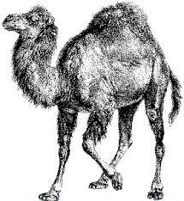
Mining
Coreference resolution → very important, 50-70% context preserved
Relation extraction → is used to output relations between NP and VP.
Relations w/ confidence >80% were held, the rest had noise and were disregarded
Tools used:
Reverb
OpenNLP
Stanford NLP
BART
Perl

Slide 8
Mining (cont.)
Coreference Resolution:
Russia armed militants guard a checkpoint in Slovyansk, Ukraine, on Monday, blocking a major highway to Kharkiv.
Russia armed militants guard a checkpoint in Slovyansk, Ukraine,{Ukraine} on Monday,{Monday_May_19} blocking a major highway to Kharkiv.

Slide 9
Mining (cont.)
Content Extraction:
Signing of deal during Obama trip raises concern over US influence and impact on Manila 's already strained Chinese ties .
arg1 & arg3 NP: Noun Phrase
arg2 VP: Verb Phrase

Slide 10
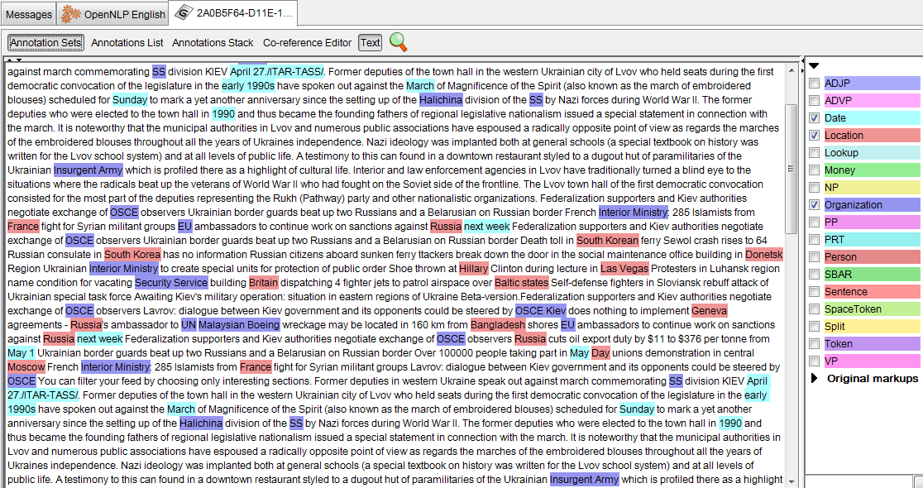
Visualization
Used:
Gephi
KNIME
GATE
Document analysis result in GATE

Slide 11
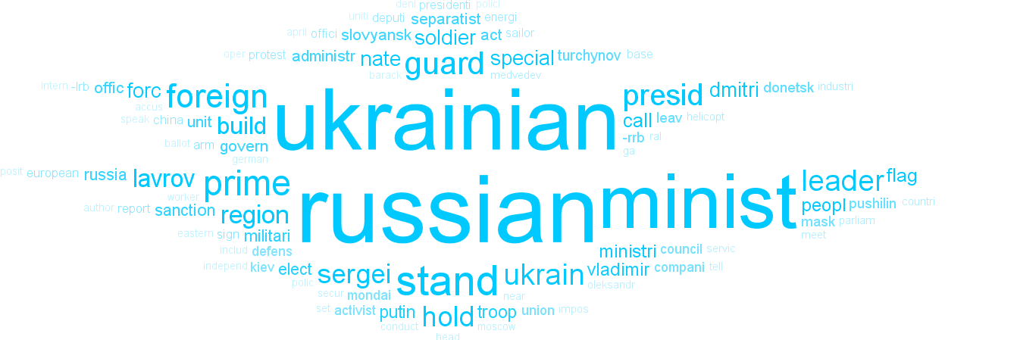
The most frequent keywords on the topic

Slide 12
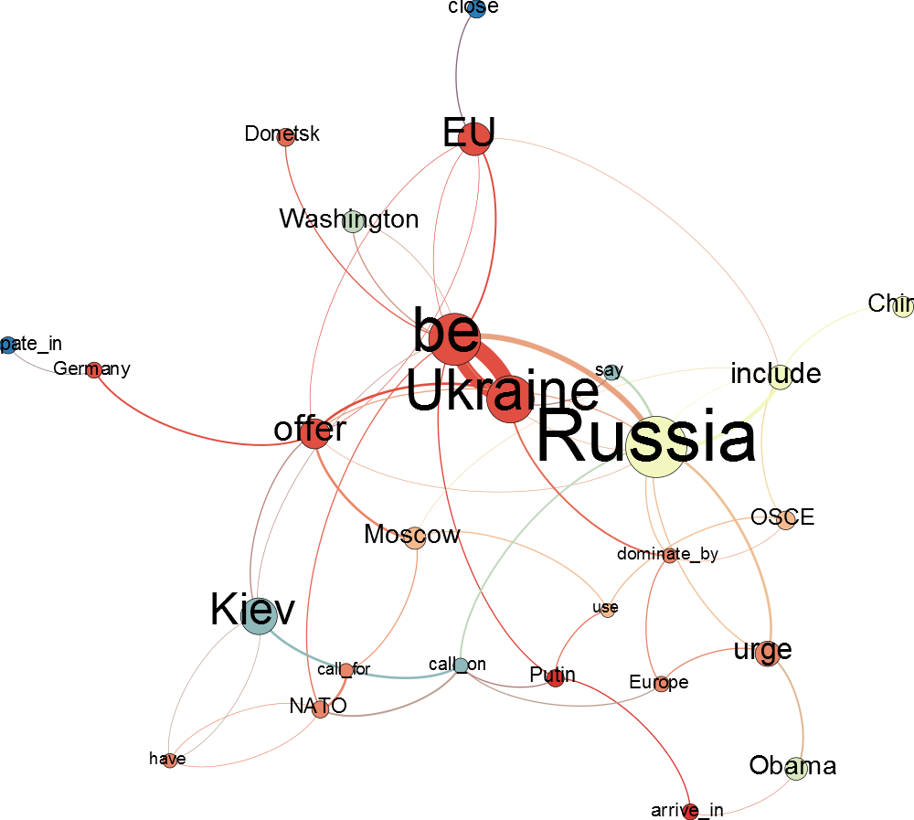
The major relations:
Size - Betweenness Centrality
Color - Modularity Class
Notes:
One way of data display. Relations are separate nodes, with their own parameters of importance. => No real meaning of the Class in that setting, Very sparse graphs, Hard to follow directions.

Slide 13
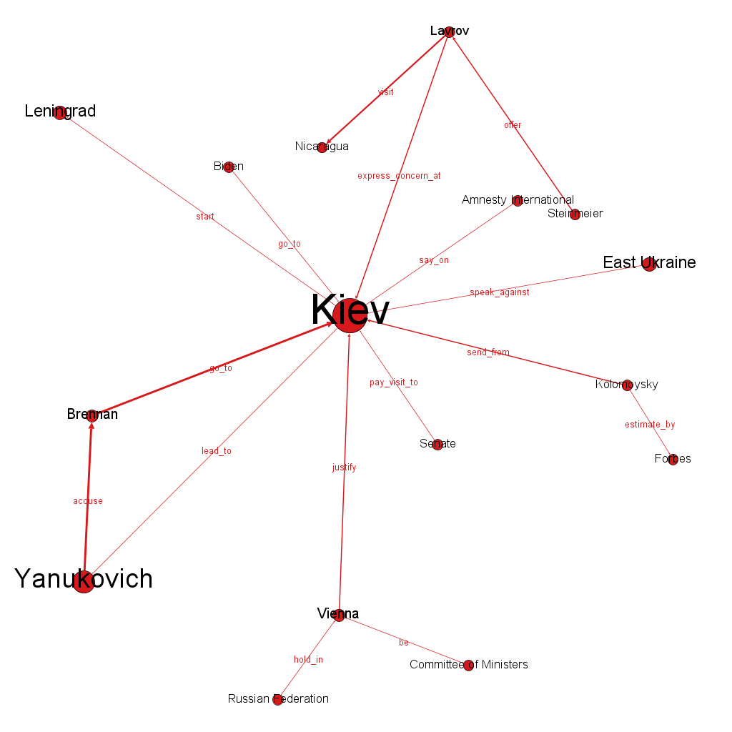
Kiev relational network:
Size - Eigenvector Centrality
Color - Class
Notes:
A different way of showing the results - labeled edges on a separated class.

Slide 14
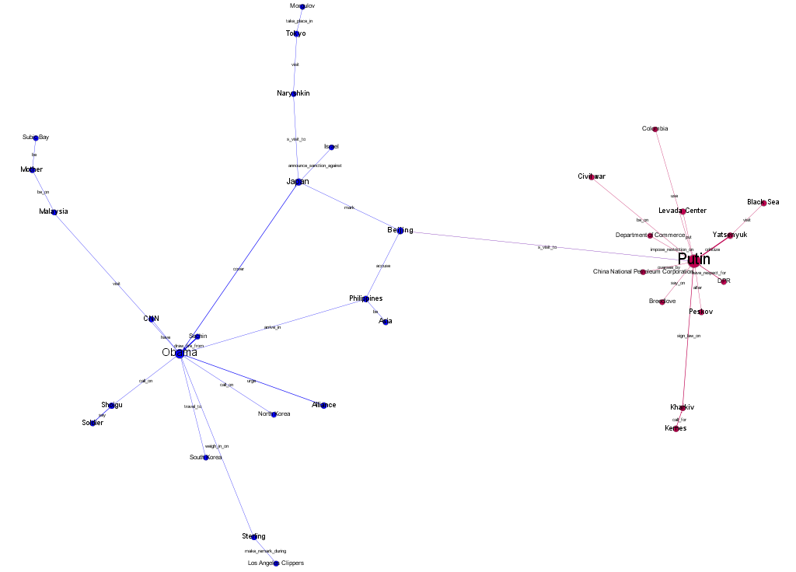
On the graph:
41% Locations
32% Persons
18% Organizations
9% Other
Obama vs Putin networks:
Size - Betweenness Centrality
Color - Class
Notes:
Obama has a much more sparse network, whereas Putin - a more compact and strong one. There is only one link between the Nets. Putin wins Obama on all of the compared parameters.

Slide 15
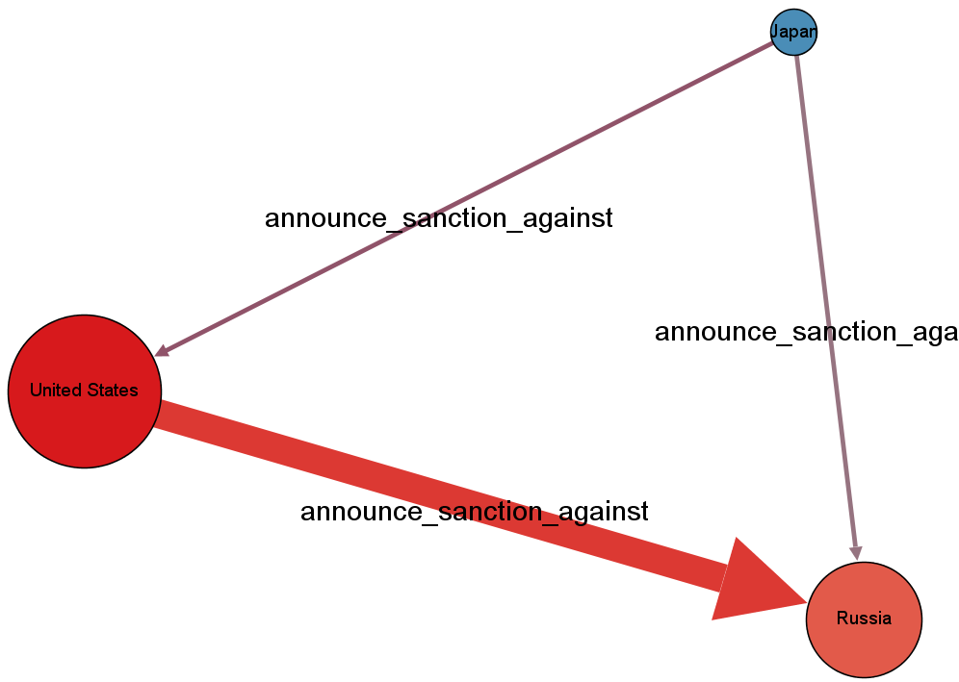
Using Gephi as a visualization means allows to:
Easily examine the relations of interest separately
Perform deep analysis of the graph parameters
Extend the graph with new features to display
Sanctions announcement:
Size - Outbound Degree
Color - Inbound Degree

Slide 16
Summary
Explored the available tools
Built the tools needed for extraction of any complex data structures from an unknown text
Performed mining of relations between Persons, Locations and Organizations
Tackled the problem of data redundancy and noisiness

